Slide 1
Result Presentation a.k.a. Solving Problem
Kantapong V. (6004640030)

Slide 2
Today’s Highlights
No picture memes today!
Watch out for FIVE key points!
3) I follow STAR (Situation-Task-Action-Result) in this presentation.

Slide 3
Demonstration
Today demonstration

Slide 4
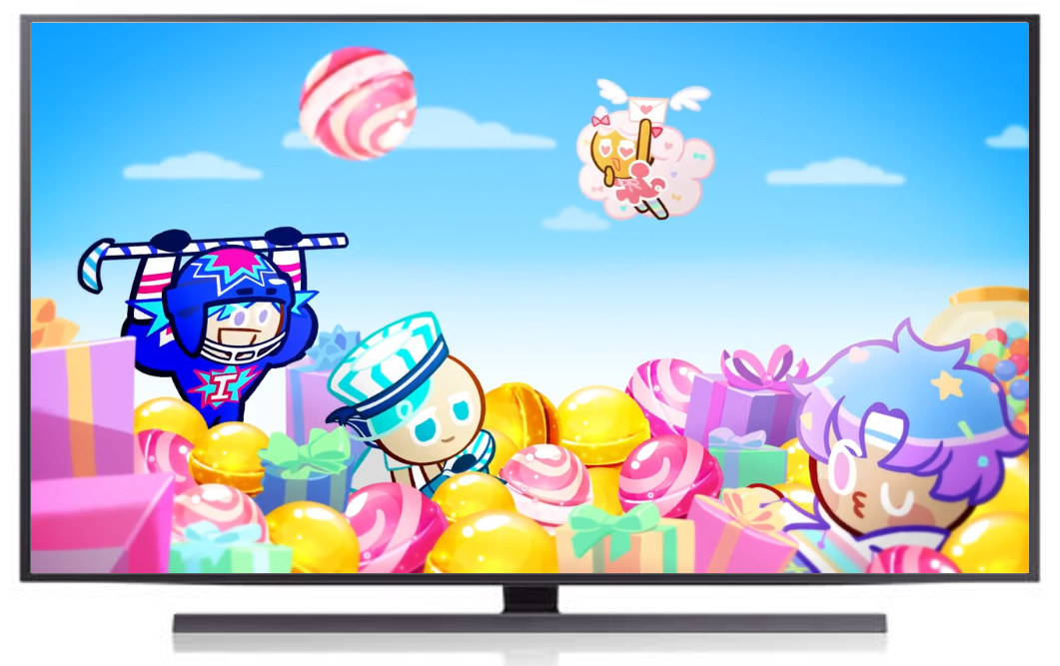
It seems easy, but the process is complicated!
For full video: click here!

Slide 5
Step 1: Define the problem
Economics Problem:
Analyze the volatility behavior of individual stocks in Thai stock market
What is the problem? → The problem is that I cannot solve this problem!

Slide 6
Step 1: Define the problem
Economics Problem:
Analyze the volatility behavior of individual stocks in Thai stock market
What is the problem? → The problem is that I cannot solve this problem!
Algorithmic Problem:
Get the regression coefficient from GARCH, GJR-GARCH run on individual stock log-return from 2015-2019

Slide 7
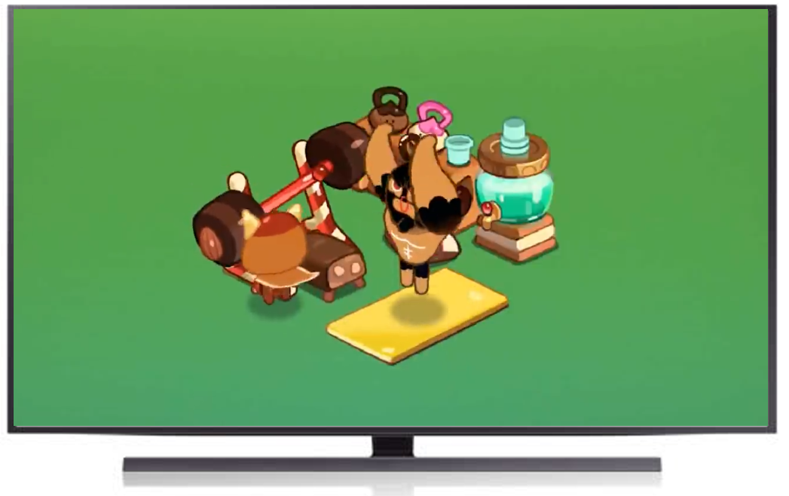
Simplify the problem
For full video: click here!

Slide 8
Assumptions
Variable of interest is log-return.
Volatility is defined as how much log-return deviates from the mean value.
Only two volatility behaviors are considered: volatility clustering and asymmetric response to shocks.
Volatility behavior does not shift in the period of 2014-2019.

Slide 9
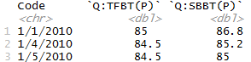
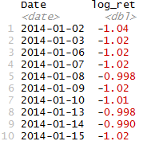
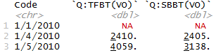
Step 2: Code the Solution
Price dataframes
What we want
Volume dataframes

Slide 10
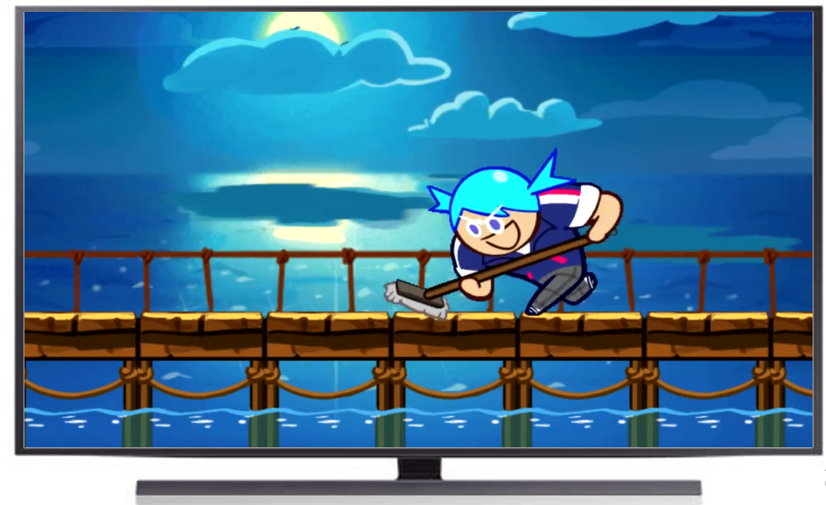
Clean the data
For full video: click here!

Slide 11
Clean data → Solve these problems
Generate log-returns out of price data
Are you sure?

Slide 12
Clean data → Solve these problems
Generate log-returns out of price data
In reality, problems that we need to solve are:
Convert column header from Q:TFBT(P) to TFBT
Filter out the holiday using volume dataframe
Filter the date to be between 2014 to 2019

Slide 13
More Assumptions (Hidden)
These are hidden assumptions when I run on the whole market:
Filter out the stocks with missing observations in either dataframe
Exclude stocks with missing observations on any attributes
Address the censoring issues
Filter the stocks with 5% significant ARCH LM test
My hidden assumptions about audience when I did this slide:
I assume that you are proficiently using the R!

Slide 14
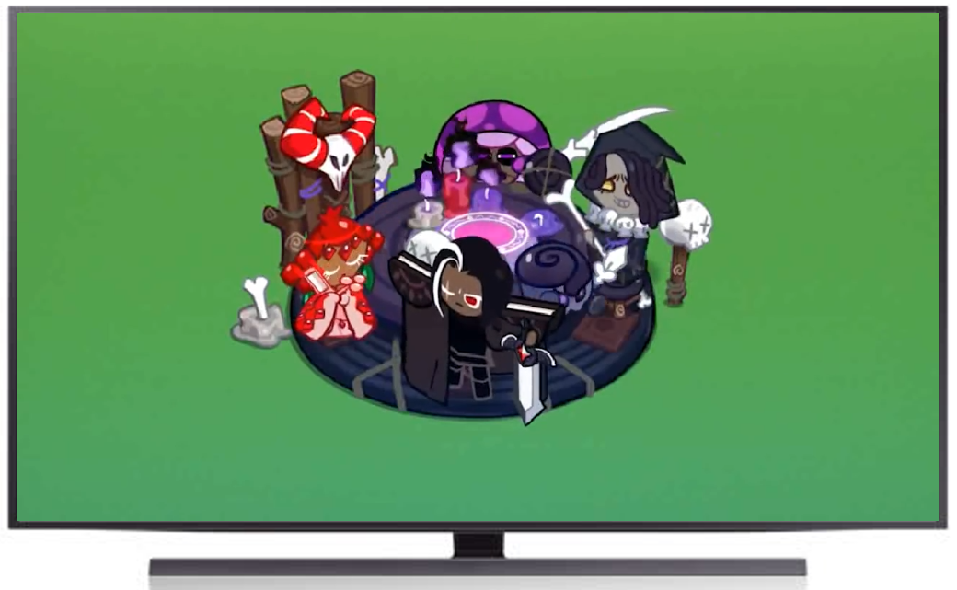
(Scalability) Do not clean by hand, use coding!
For full video: click here!

Slide 15
Step 3: Conduct the modelling
What package will you be using?
What is the pipeline in making the model?
How do you make the process scalable (performance issues)?
Do not use hand, use computer!

Slide 16
Step 4: Communicate your Result
If you follow those guidelines on previous three steps, it will be easy!
Mention assumptions when analyzing data
Describe what you see
Infer what you think, but not too much!

Slide 17

Research study is not gambling!
For full video: click here!

Slide 18
Conclusions
Presentation seems easy, but the process is complicated!
Simplify problem by making assumptions.
Clean the data.
Use automation, not your hand.
Research vs. gacha

